Slide 1


A Generalized PSS Architecture for Balancing Transient and Small-Signal Response
Ryan T. Elliott , Payman Arabshahi , and Daniel S. Kirschen
IEEE Transactions on Power Systems, Vol.35, No. 2, pp.1446-1456, March 2020
Athul Jose P
11867566

Slide 2


Introduction
WSU
RE Deployment
Protection Aspects
Exponential increase in renewable penetration
Increase in inverter based systems
Stability and protection issues
Network topology
Fault characteristics
Violation of assumptions of traditional schemes
R. T. Elliott, P. Arabshahi, and D. S. Kirschen, ‘‘A generalized PSS architecture for balancing transient and small-signal response,’’ IEEE Trans. Power Syst., vol. 35, no. 2, pp. 1446–1456, Mar. 2020.

Slide 3
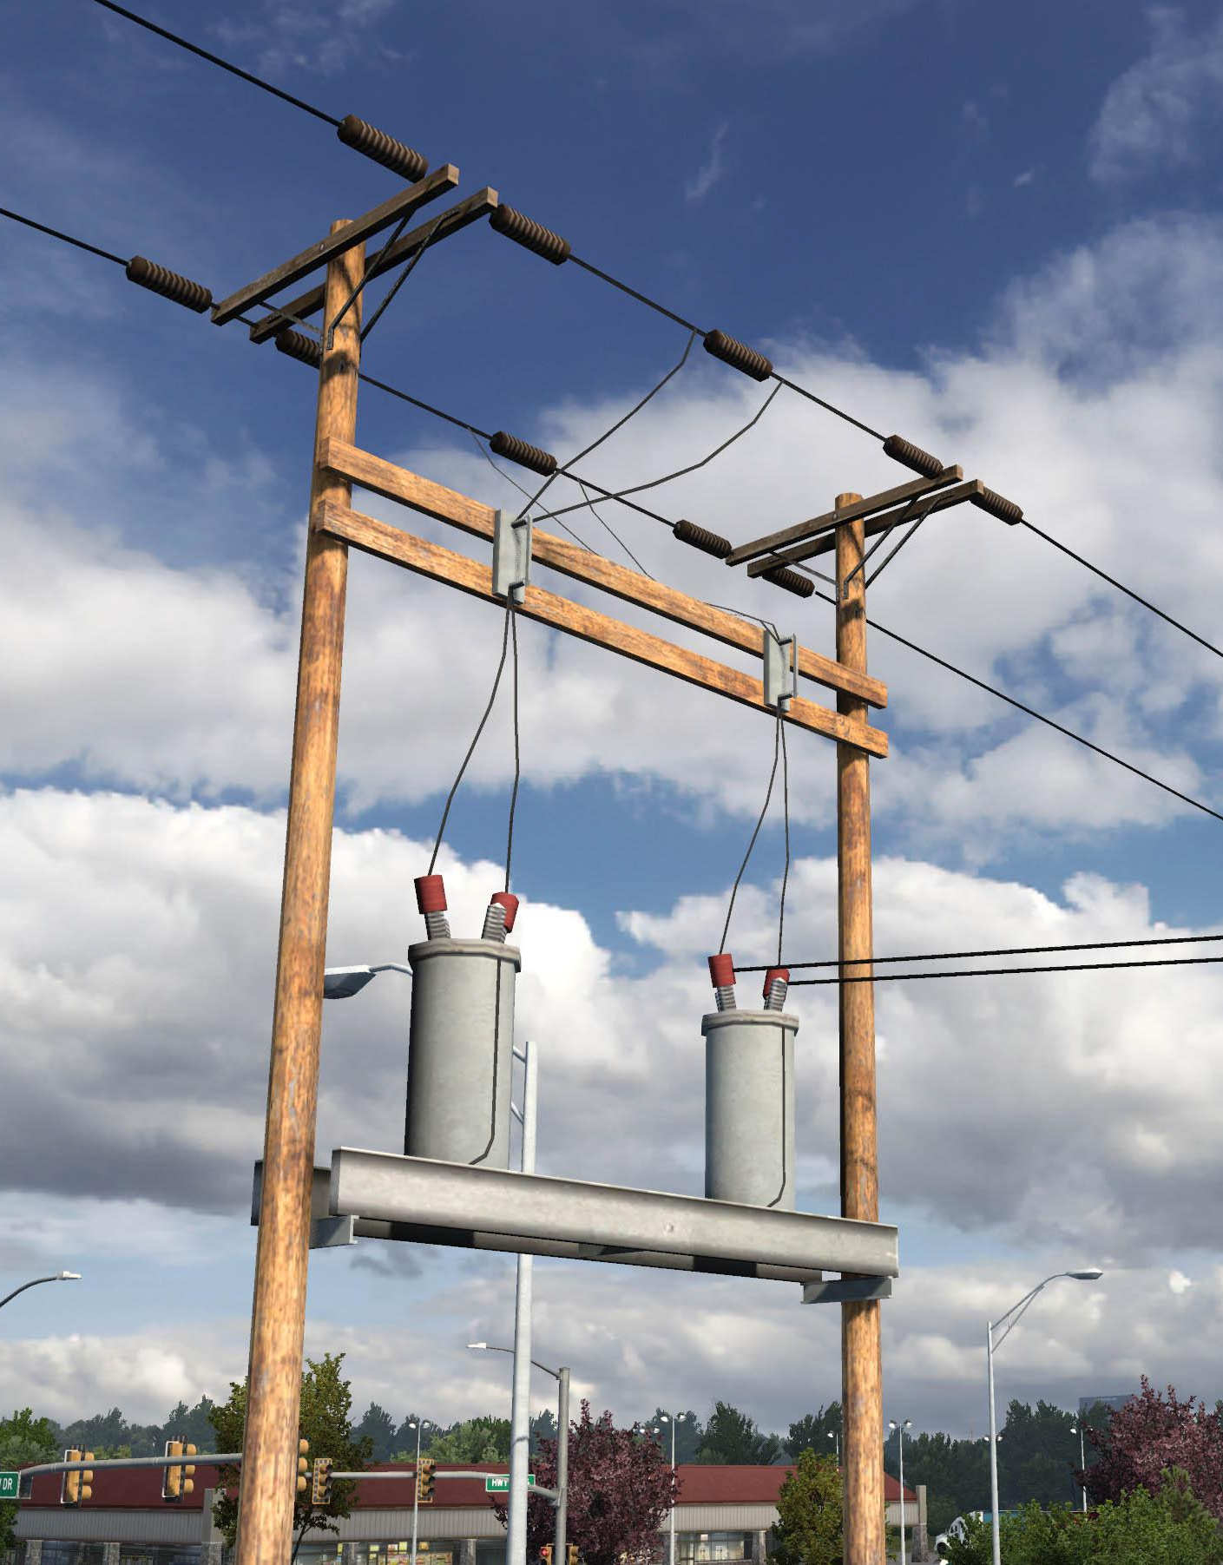
DISTRIBUTION
WSU

Slide 4
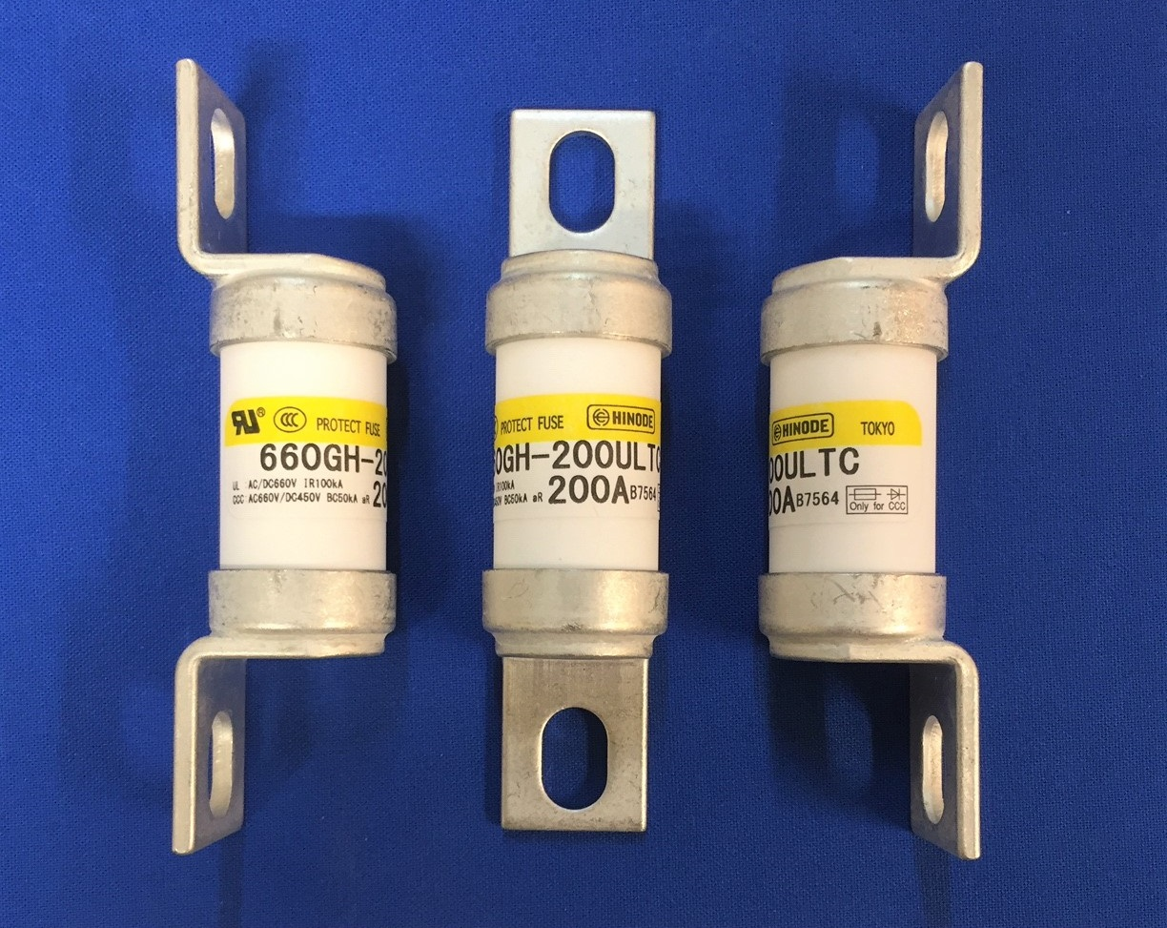
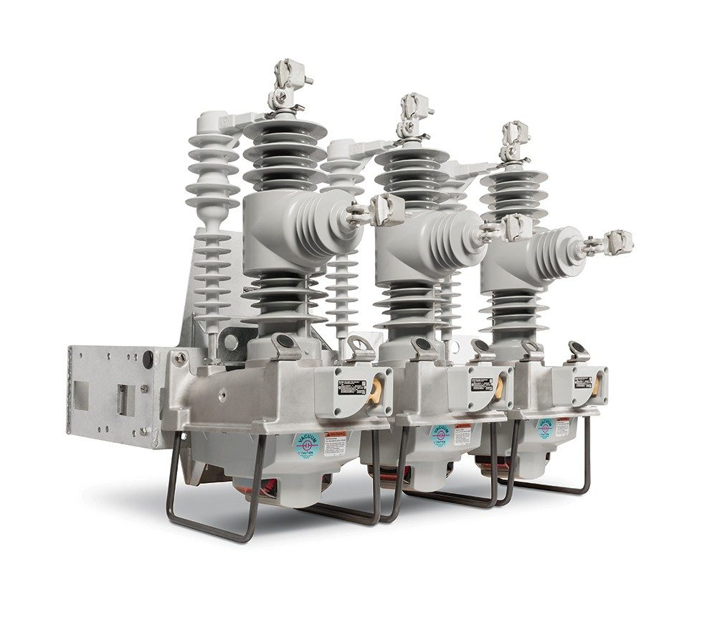
Distribution System
WSU
Protection elements are
Fuse
Over current elements with reclosers
Protection schemes based on fault current
Topology of network plays role in coordination
Unidirectional power flow
True load vs net load
T. E. McDermott, R. Fan, P. Thekkumparambath Mana, B. G. Vyakaranam, T. Smith, J. Hambrick, Z. Li, and A. Barnes, “Relaying for distribution and microgrids evolving from radial to bidirectional power flow,” Pacific Northwest National Lab.(PNNL), Richland, WA (United States), Tech. Rep., 2019

Slide 5
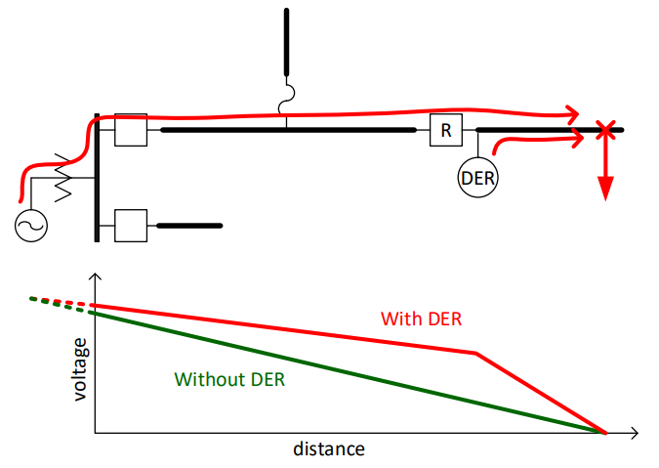
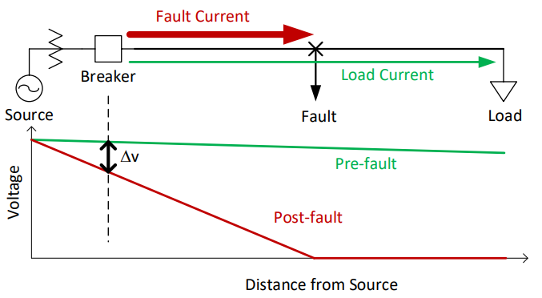
Topology Related
WSU
T. E. McDermott, R. Fan, P. Thekkumparambath Mana, B. G. Vyakaranam, T. Smith, J. Hambrick, Z. Li, and A. Barnes, “Relaying for distribution and microgrids evolving from radial to bidirectional power flow,” Pacific Northwest National Lab.(PNNL), Richland, WA (United States), Tech. Rep., 2019

Slide 6
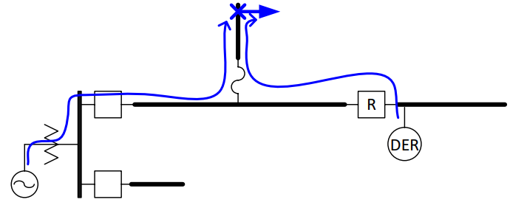
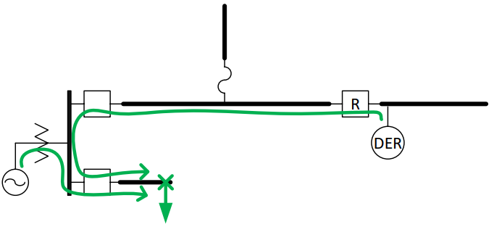
Topology Related
WSU
T. E. McDermott, R. Fan, P. Thekkumparambath Mana, B. G. Vyakaranam, T. Smith, J. Hambrick, Z. Li, and A. Barnes, “Relaying for distribution and microgrids evolving from radial to bidirectional power flow,” Pacific Northwest National Lab.(PNNL), Richland, WA (United States), Tech. Rep., 2019

Slide 7
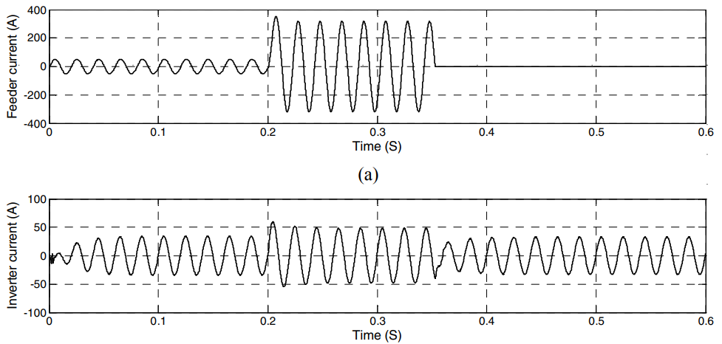
Fault Current from Inverters
WSU
Main component of inverter is switches
Semi conductor switches are prone to high currents
Every inverter will be equipped with current limiting control to protect switches
Fault current is limited
Massoud, S. Ahmed, S. Finney, and B. Williams, “Inverter-based versus synchronous-based distributed generation; fault current limitation and protection issues,” in 2010 IEEE energy conversion congress and exposition. IEEE, 2010, pp. 58–63

Slide 8
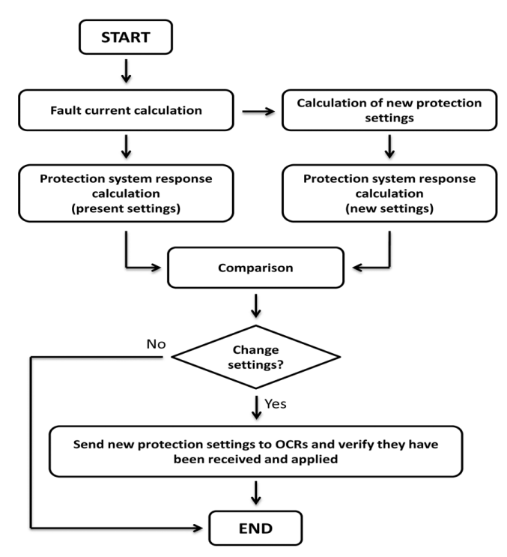
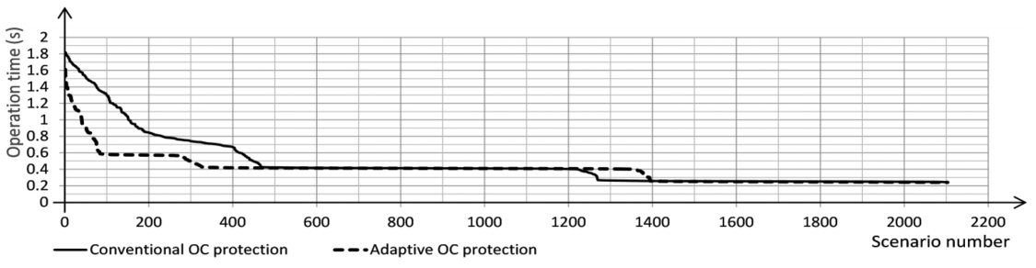
Adaptive Over Current Relay
WSU
F. Coffele, C. Booth, and A. Dy ́sko, “An adaptive overcurrent protection scheme for distributionnetworks,” IEEE transactions on power delivery, vol. 30, no. 2, pp. 561–568, 2014

Slide 9
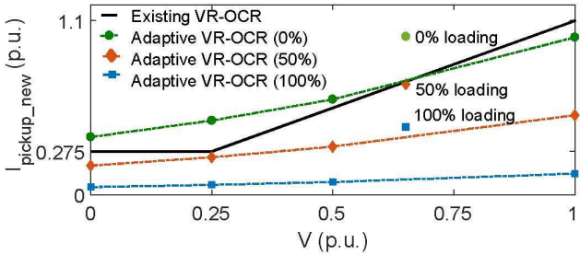
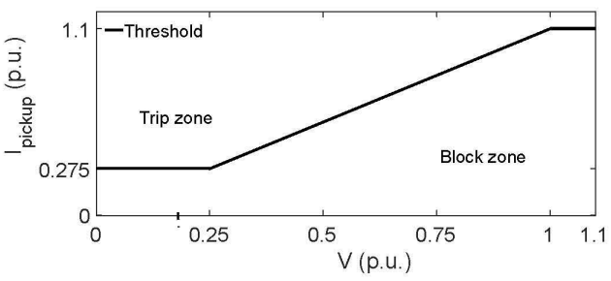
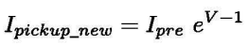
Adaptive VR-OCR
WSU
Mishra, A. K. Pradhan, and P. Bajpai, “Adaptive voltage restrained overcurrent relaying for protection of distribution system with pv plant,” in 2021 9th IEEE International Conference on Power Systems (ICPS). IEEE, 2021, pp. 1–5.

Slide 10


TRANSMISSION
WSU

Slide 11
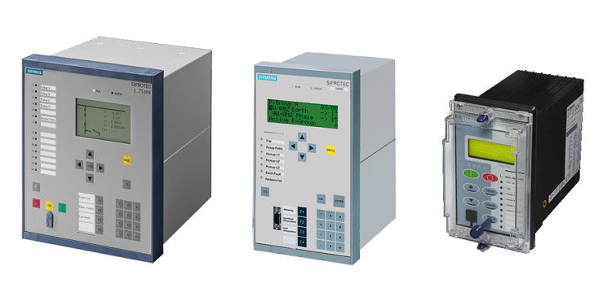
Transmission System
WSU
Protection elements are Numerical Relays
Protection schemes based on fault current and voltage
Topology of network
Bidirectional power flow
Multiple protection elements
Protection elements are based on phasor domain analysis

Slide 12
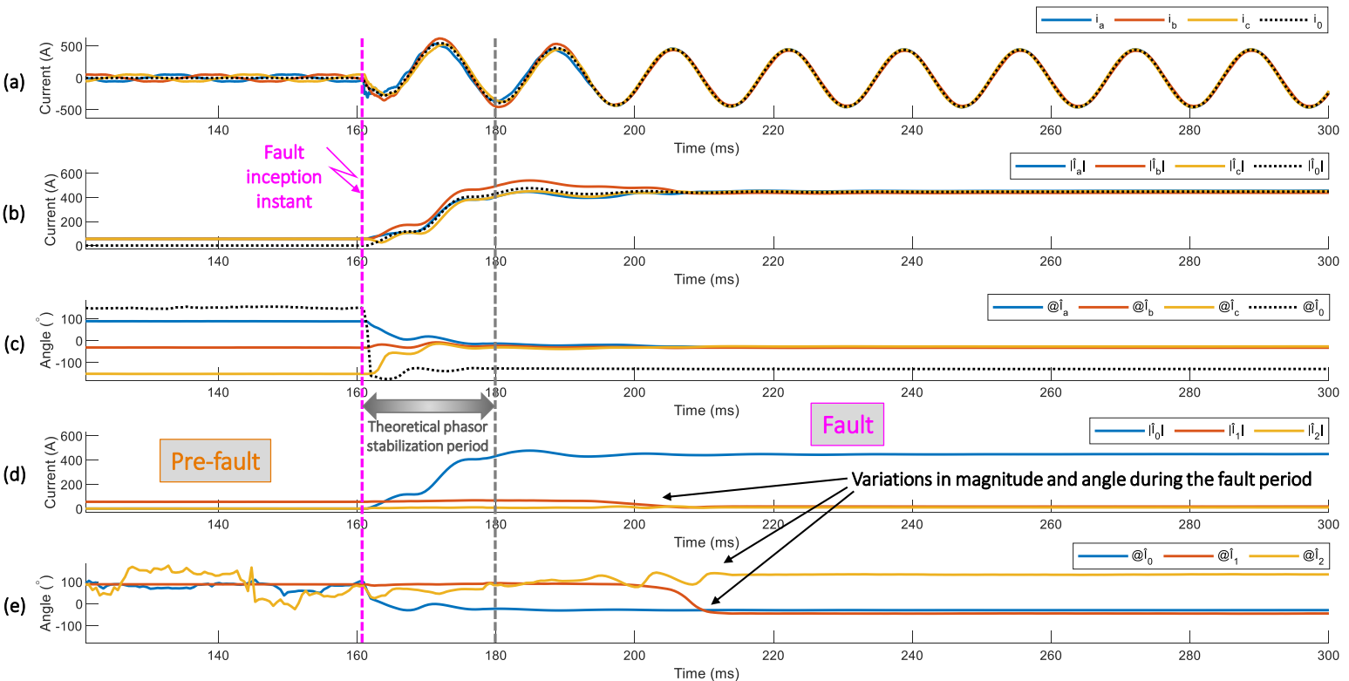
Phasor Domain Analysis
WSU
F. V. Lopes, M. J. Davi, M. Oleskovicz, and G. B. Fabris, “Importance of emt-type simulations for protection studies in power systems with inverter-based resources,” in 2022 Workshop on Communication Networks and Power Systems (WCNPS). IEEE, 2022, pp. 1–6

Slide 13
Need for EMT Analysis
WSU
IBR transient event can only be represented in EMT
Inverter switching, fault response, crowbar operation
Presence of non fundamental components
Presence of frequency dependent components
Extended to TW approach
F. V. Lopes, M. J. Davi, M. Oleskovicz, and G. B. Fabris, “Importance of emt-type simulations for protection studies in power systems with inverter-based resources,” in 2022 Workshop on Communication Networks and Power Systems (WCNPS). IEEE, 2022, pp. 1–6

Slide 14
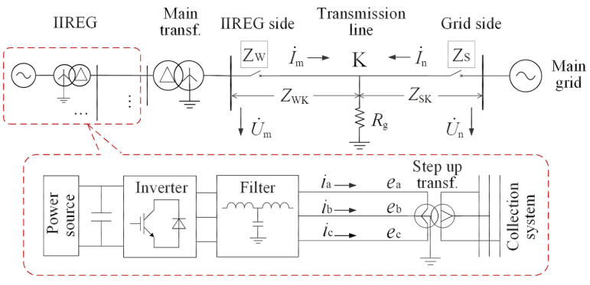
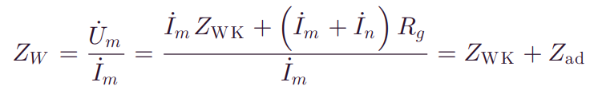
Distance Protection
WSU
Fang, K. Jia, Z. Yang, Y. Li, and T. Bi, “Impact of inverter-interfaced renewable energy generators on distance protection and an improved scheme,” IEEE Transactions on Industrial Electronics, vol. 66, no. 9, pp. 7078–7088, 2018

Slide 15
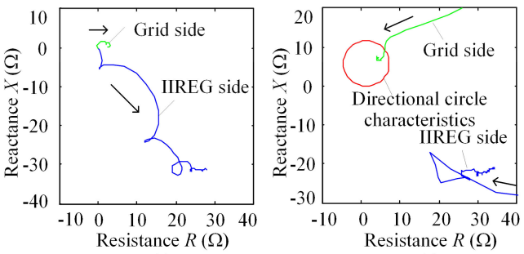
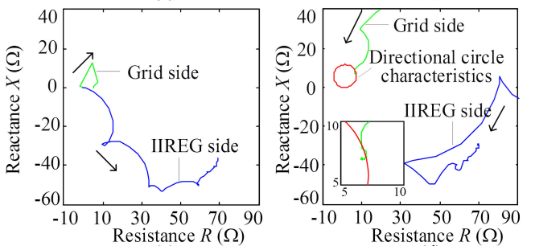
Distance Protection
WSU
Fang, K. Jia, Z. Yang, Y. Li, and T. Bi, “Impact of inverter-interfaced renewable energy generators on distance protection and an improved scheme,” IEEE Transactions on Industrial Electronics, vol. 66, no. 9, pp. 7078–7088, 2018

Slide 16
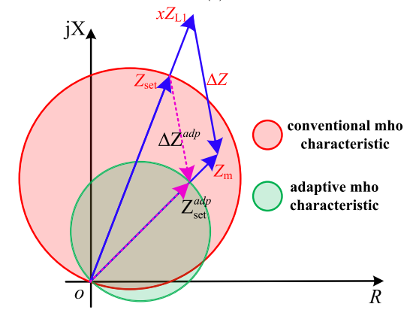
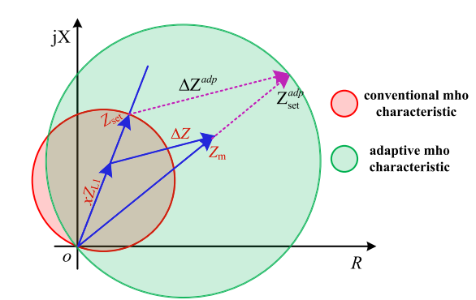
Adaptive MHO Relay
WSU
Y. Liang, W. Li and W. Zha, "Adaptive Mho Characteristic-Based Distance Protection for Lines Emanating From Photovoltaic Power Plants Under Unbalanced Faults," in IEEE Systems Journal, vol. 15, no. 3, pp. 3506-3516, Sept. 2021, doi: 10.1109/JSYST.2020.3015225

Slide 17
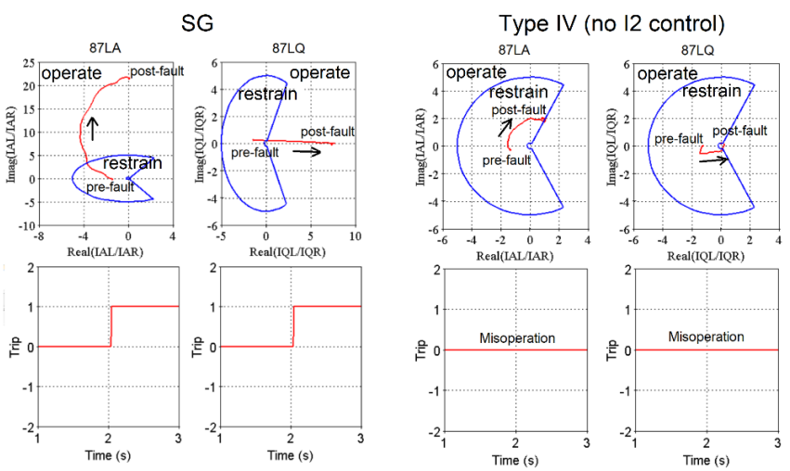
Line Current Differential
WSU
Haddadi, E. Farantatos, I. Kocar, and U. Karaagac, “Impact of inverter based resources on system protection,” Energies, vol. 14, no. 4, p. 1050, 2021

Slide 18
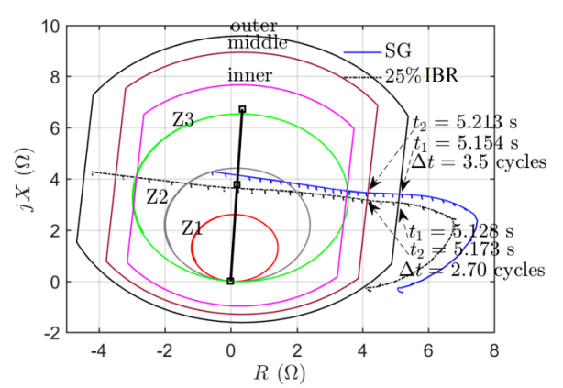
Power Swing Blocking
WSU
Haddadi, E. Farantatos, I. Kocar, and U. Karaagac, “Impact of inverter based resources on system protection,” Energies, vol. 14, no. 4, p. 1050, 2021

Slide 19


Conclusion
WSU
As a result of renewable integration, protection systems are highly affected. This is mainly because of the presence of inverters and change in topology.
Faster and advanced techniques can be employed to resolve the protection issues of the power system
Modeling of newly introduced DERs and its EMT analysis became necessary for doing protection studies

Slide 20

References
WSU
V. Telukunta, J. Pradhan, A. Agrawal, M. Singh, and S. G. Srivani, “Protection challenges under bulk penetration of renewable energy resources in power systems: A review,” CSEE journal of power and energy systems, vol. 3, no. 4, pp. 365–379, 2017
T. E. McDermott, R. Fan, P. Thekkumparambath Mana, B. G. Vyakaranam, T. Smith, J. Hambrick, Z. Li, and A. Barnes, “Relaying for distribution and microgrids evolving from radial to bidirectional power flow,” Pacific Northwest National Lab.(PNNL), Richland, WA (United States), Tech. Rep., 2019
Massoud, S. Ahmed, S. Finney, and B. Williams, “Inverter-based versus synchronous-based distributed generation; fault current limitation and protection issues,” in 2010 IEEE energy conversion congress and exposition. IEEE, 2010, pp. 58–63
F. Coffele, C. Booth, and A. Dy ́sko, “An adaptive overcurrent protection scheme for distributionnetworks,” IEEE transactions on power delivery, vol. 30, no. 2, pp. 561–568, 2014
Mishra, A. K. Pradhan, and P. Bajpai, “Adaptive voltage restrained overcurrent relaying for protection of distribution system with pv plant,” in 2021 9th IEEE International Conference on Power Systems (ICPS). IEEE, 2021, pp. 1–5.
F. V. Lopes, M. J. Davi, M. Oleskovicz, and G. B. Fabris, “Importance of emt-type simulations for protection studies in power systems with inverter-based resources,” in 2022 Workshop on Communication Networks and Power Systems (WCNPS). IEEE, 2022, pp. 1–6
Fang, K. Jia, Z. Yang, Y. Li, and T. Bi, “Impact of inverter-interfaced renewable energy generators on distance protection and an improved scheme,” IEEE Transactions on Industrial Electronics, vol. 66, no. 9, pp. 7078–7088, 2018
Y. Liang, W. Li and W. Zha, "Adaptive Mho Characteristic-Based Distance Protection for Lines Emanating From Photovoltaic Power Plants Under Unbalanced Faults," in IEEE Systems Journal, vol. 15, no. 3, pp. 3506-3516, Sept. 2021, doi: 10.1109/JSYST.2020.3015225
Haddadi, E. Farantatos, I. Kocar, and U. Karaagac, “Impact of inverter based resources on system protection,” Energies, vol. 14, no. 4, p. 1050, 2021

Slide 21

WSU
Thank You
Questions?

